Slide 1
Pediatric behavioral health and psychological health pearls for the primary care provider
Pollyanna Kabara, MS, PA-C
Concordia University Wisconsin

Slide 2
To obtain the PPT of the Presentation please email me at Pollyanna.kabara@cuw.edu

Slide 3
Disclosures
I have no financial affiliations with the resources that I will be sharing with you
Resources listed are ones I have utilized during my career- there are many others out there. I am not intentionally endorsing any specific healthcare organization, nor any individual provider.
This presentation does not discuss medication treatment

Slide 4
Scary and sad statistics
One in five Wisconsin kids under age 18 has had a mental or behavioral health disorder in the past year
50 percent of mental illness shows symptoms before age 14, but it takes an average of 11 years for kids to receive their first treatment
70 percent of depressed kids in Wisconsin won’t get the care they need
Wisconsin’s youth suicide rate is the second highest in the nation at 3.4 per 100,000 children
- Quoted from Children’s Hospital of Wisconsin, 2018

Slide 5
Objectives:
Discuss the use of developmental screening tools to identify concerns of developmental delay, and identify appropriate patient referral.
Identify presenting signs and symptoms of ADD, ADHD, autism spectrum disorder, anxiety, OCD, and depression.
Select age appropriate screening tools for various mood disorders.
Identify treatment locations for patients in Wisconsin

Slide 6
Developmental screening tools

Slide 7
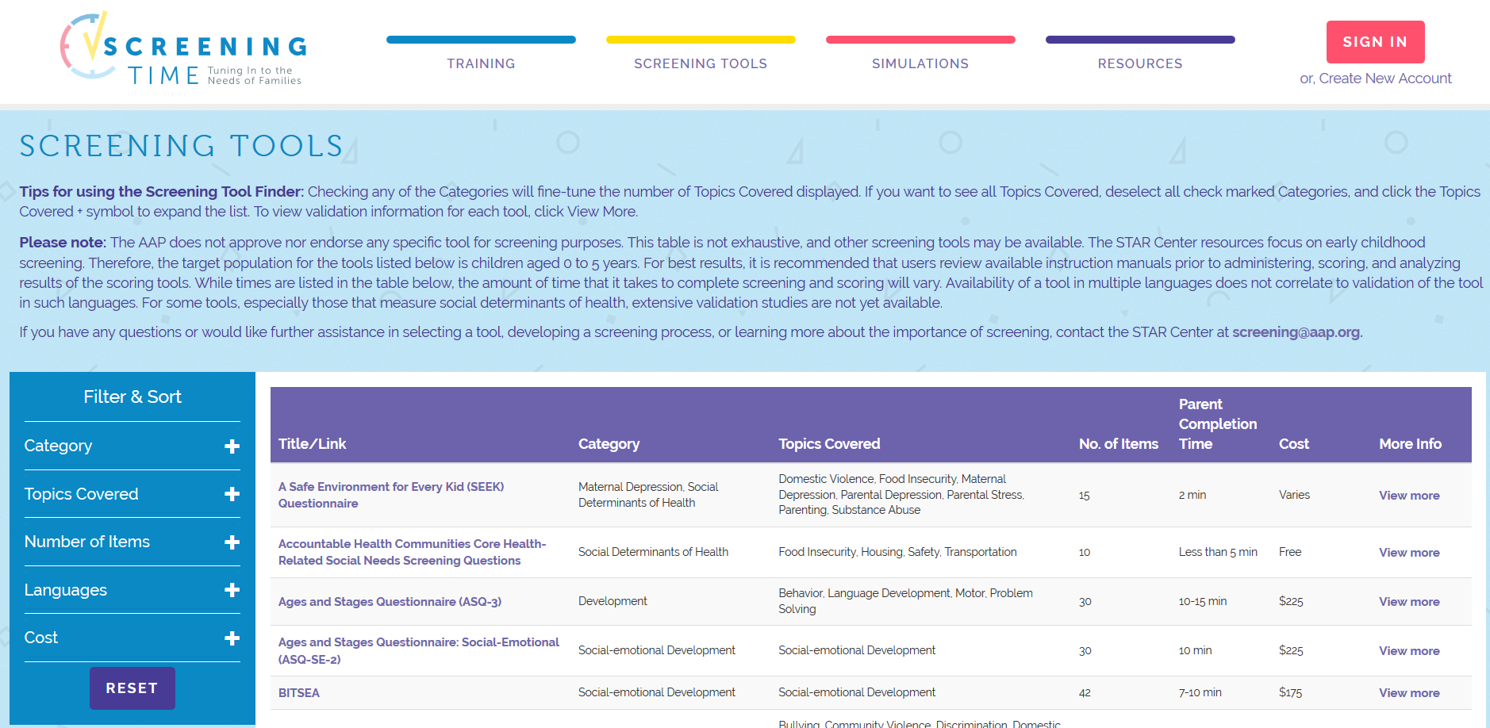
AAP Table of screening tools
https://screeningtime.org/star-center/#/screening-tools#top

Slide 8
developmental screening tools to identify concerns of developmental delay
‘ASQ’ Ages and Stages Questioner
https://agesandstages.com/about-asq/
Purchased by the clinic
Ages 2 months to 60 months
Parents/caregivers complete prior to each WCC
Interventions are recommended based on parent/caregiver data and data obtained during the history and physical exam
Example of a blank ASQ
Example of a completed ASQ

Slide 9
developmental screening tools to identify concerns of developmental delay
Modified Checklist for Autism in Toddlers (MCHAT)
Free! https://mchatscreen.com/
Ages 16-30 months
Parents/caregivers complete prior to each WCC
Interventions are recommended based on parent/caregiver data and data obtained during the history and physical exam
Example of a blank MCHAT

Slide 10
Red Flags in infant development
Unable to sit alone by age 9 months
Unable to transfer objects from hand to hand by age 1 year
Abnormal pincer grip or grasp by age 15 months
Unable to walk alone by 18 months
Failure to speak recognizable words by 2 years
Developmental pattern is falling off

Slide 11
appropriate patient referral for patients who have developmental delay
Birth to Three Program
https://www.dhs.wisconsin.gov/birthto3/index.htm
If over the age of three, refer individually to appropriate specialists
OT
PT
SLP
Audiology

Slide 12
Nice resource for parents with high health literacy https://www.healthychildren.org/English/ages-stages/toddler/Pages/Assessing-Developmental-Delays.aspx

Slide 13
Early intervention (Birth to three program )

Slide 14
Birth to Three: AKA, Early Intervention (EI) Part C of the Individuals with Disabilities Education Act

Slide 15
Birth to Three Mission Statement
The Wisconsin Birth to 3 Program is committed to serving children under the age of 3 with developmental delays and disabilities and their families.
We work to enhance the child’s development and support the family’s knowledge, skills and abilities as they interact with and raise their child.

Slide 16
Eligibility
Age: birth - 36 months
Diagnosed disability OR
Significant delay (25%) in one or more areas
Cognitive development
Physical/motor development
Speech and language
Social/emotional
Adaptive
If the child is eligible, an Individualized Family Service Plan (IFSP) is developed with the family outlining concerns, what strategies, and what early interventions services will be provided. A service coordinator assists in locating these recommended services.

Slide 17
Services
Who is involved: PT, OT, Communication services, Education services, Family education developmental, etc.
Focused on enhancing
Communication
Sensory awareness
Cognition
Gross and fine motor skills
Social development
Adaptive living skills

Slide 18
Referrals
https://www.dhs.wisconsin.gov/birthto3/family/referrals.htm
Each county of the state has established referral network
These members are part of network and can make a referral:
Parents
Health care providers
Schools
Child care providers
Public health nurses
Hospitals

Slide 19
Example of Waukesha county referral

Slide 20
Birth to three services
Coordinator of Services
Early Education Programs
OT/PT/Speech/Nursing/Social Work
Parent Support Services
Assistive technology devices and services
Audiology
Vision
Transportation

Slide 21
birth to three services
Termination occurs in one of two ways:
Child turns three years old
Previously identified developmental gaps have resolved

Slide 22
Autism spectrum disorder (ASD)

Slide 23
presenting signs and symptoms of autism spectrum disorder
Language delays or peculiar speech patterns
Social delays - poor eye contact, resists touching, appears "tuned out", poor interactions and lack of interest in peers and family members
Unusual response to sensory stimuli
Intellectual ability varies
Ritualistic movements and/or obsessive compulsive behaviors
Extreme hyperactivity or passivity (They are “good” babies)
Absence of symbolic play
Most children have a normal physical appearance and physical examination

Slide 24
Signs and symptoms of Autism https://www.autismspeaks.org/what-autism/symptoms

Slide 25
Red flags for asd
No declarative pointing
Failing 2 y/o screening (autism screening checklist- MCHAT)
No babbling by 12 months of age
No pointing or gestures by 12 months
No single words by 18 months
No two word phrases by 2 years of age
Any deterioration of language or social skills

Slide 26
DSM-V Diagnostic Criteria for ASD (copied from UptoDate)

Slide 27
ASD Severity level from UptoDate

Slide 28
ASD screening Tools for children <3 y/o
Most commonly used, and recommended by the AAP: M-CHAT-R/F
Others:
CHAT
STAT
ITC
POSI

Slide 29
M-CHAT-R/F (Modified CHAT Revised with follow-up)
M-CHAT-R/F (Revised with follow-up)
16-30 months
20 Parent reported items
Is my child deaf? What led them to wonder that?
Does your child like climbing on things?
Unusual finger movements towards eyes?
Do they smile back?
Upset by every day noises? (Vacuum or loud music)
https://www.m-chat.org/mchat.php

Slide 30
CHAT: Checklist for Autism in Toddlers
CHAT 18-24 months
9 parent reported items & 5 observed Items
https://www.rch.org.au/genmed/clinical_resources/CHecklist_for_Autism_in_Toddlers_CHAT/

Slide 31
STAT: screening tool for autism in 2 y/o
STAT 24-36months
12 observed activities during a 20 min play session
http://stat.vueinnovations.com/about

Slide 32
ITC: infant toddler checklist
ITC 6-24 months
24 item questionnaire
https://firstwords.fsu.edu/pdf/checklist.pdf

Slide 33
POSI: parents observations of social interactions
POSI
18-35 months
7 parent report items
<5 min survey
http://njaap.org/uploadfiles/documents/PCORE/CAN/SWYC/POSI%20Scoring%20Guide%2011-25-13%20v2.pdf

Slide 34
Tools for Preschool & School age Children
SCQ
CAST
ASSQ
AQ-Child
DBC-ASA
DBC-ES

Slide 35
SCQ: social communication questionnaire
SCQ
4-40y/o
40 parent reported items
http://www.wpspublish.com/store/p/2954/social-communication-questionnaire-scq

Slide 36
CAST: childhood autism syndrome test
CAST
4-11y/o
37 Parent reported items
https://psychology-tools.com/cast/

Slide 37
ASSQ: Autism spectrum screening questionnaire
ASSQ
7-16y/o
27 item checklist to be completed by parents or teachers
Validated for a first year screen for children with high functioning ASD
http://www.ementalhealth.ca/index.php?m=survey&ID=27

Slide 38
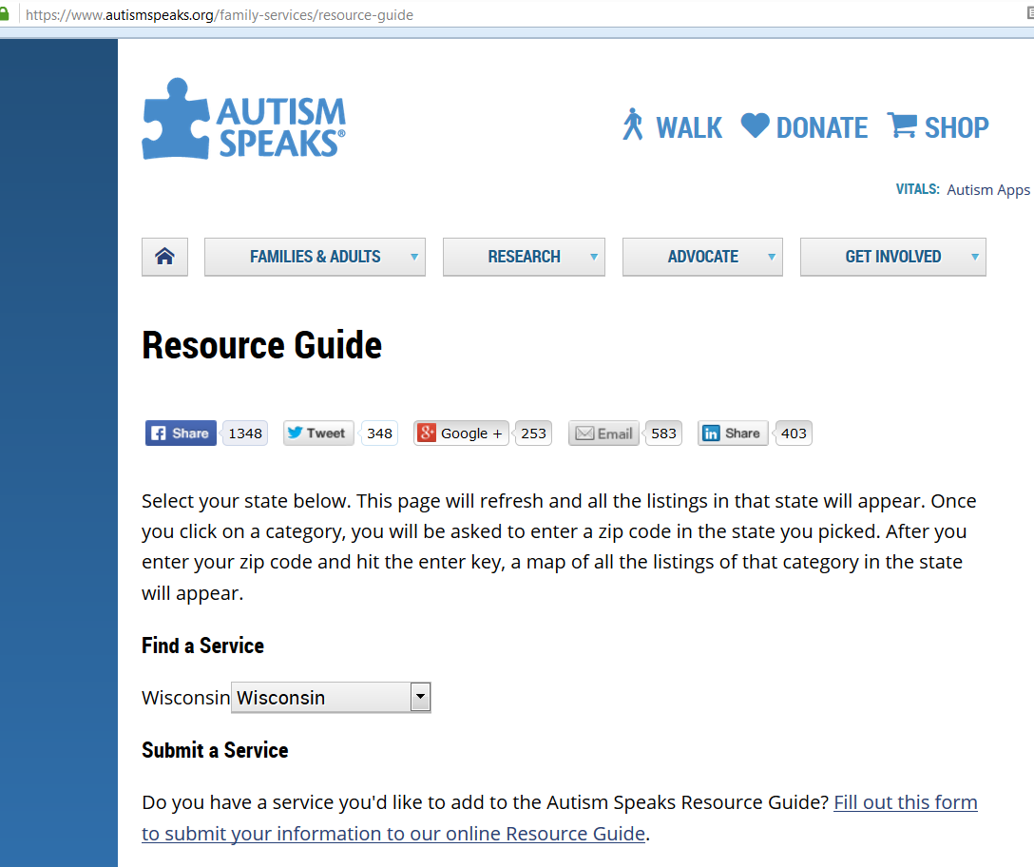
local resource
https://www.autismspeaks.org/family-services/resource-guide

Slide 39
Referral for patients who may have asd
Birth to Three if age eligible
Neuropsych testing: they will determine which tests to give patient
(see next slide)
Counselor/therapist (see slide of local resources at the end of the presentation)
Support groups, such as local autism speaks chapters

Slide 40
Neuropsychological evaluation
Used to diagnose and follow ASD, ADD, ADHD, and psychologic disorders, such as depression, anxiety, bipolar disorder
A few local resources (there are many others- patients should check with their insurance):
Children’s Hospital of WI Neuropsych: (414) 955-0660
https://www.chw.org/medical-care/neuroscience/programs-and-services/neuropsychology
UWM: 414-229-5521
https://uwm.edu/psychology/clinic/child-neuropsychology-specialty-clinic-2/
Aurora Neuropsych: Dr. Gallow and Dr. Wochos : 414-385-8771 https://www.aurorahealthcare.org/doctors/frank-j-gallo-phd
https://www.aurorahealthcare.org/doctors/gregory-wochos-phd
Pediatric Neuropsychology and Treatment Associates (262) 347-0701 http://www.pednta.com/
Dr. Glassman https://www.glassmanneuropsychology.com/ (414) 444-9811

Slide 41
ADD and ADHD

Slide 42
ADD/ADHD Presenting signs and symptoms
Group of symptoms characterized by:
Developmentally inappropriate levels of inattention
Impulsivity
Hyperactivity
Can have a mixed form
Tends to manifest in early childhood
May result in:
delays in academic and vocational achievement
poor social relationships
low performance of daily living skills relative to their intellectual potential

Slide 43
https://www.healthychildren.org/English/health-issues/conditions/adhd/Pages/Diagnosing-ADHD-in-Children-Guidelines-Information-for-Parents.aspx

Slide 44
Common screening tools for ADD and ADHD
Vanderbilt (available on-line) – parent/caregiver and teacher can asses
https://www.nichq.org/sites/default/files/resource-file/NICHQ-Vanderbilt-Assessment-Scales.pdf
https://www.nichq.org/resource/nichq-vanderbilt-assessment-scales
Connors (must purchase) – parent/caregiver, child (8 years and older) and teachers can assess
https://www.mhs.com/MHS-Assessment?prodname=conners3

Slide 45
Connors tool

Slide 46
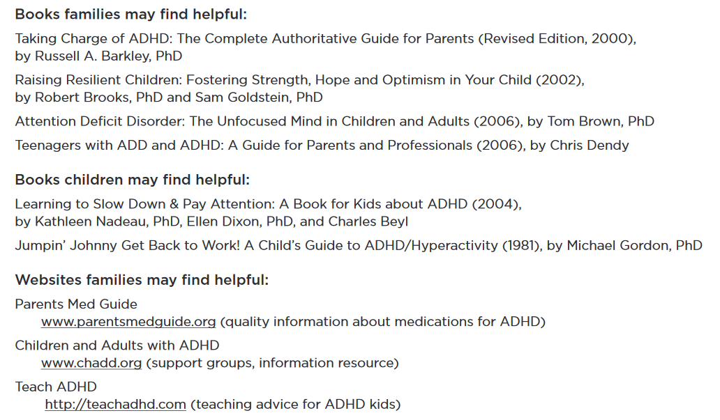
Wonderful resources for families
https://www.seattlechildrens.org/globalassets/documents/healthcare-professionals/pal/7.2-adhd-resources.pdf:

Slide 47
Referrals
Psychotherapy: Counselor/therapist
(see slide of local resources at the end of the presentation)
Intensive treatment via outpatient partial hospitalization or intensive outpatient therapy for behavior modification is sometimes indicated
(see slide with local resources at the end of the presentation)

Slide 48
Mood disorders

Slide 49
Great resource for mood disorders:
https://www.seattlechildrens.org/conditions/brain-nervous-system-mental-conditions/depression/?gclid=Cj0KCQiAgf3gBRDtARIsABgdL3m6Fu_ZlDgwe25T8nKfWyBlVDbb9R07ntBahqOlanBJm3kplFmYsVIaAknoEALw_wcB

Slide 50
Anxiety and Obsessive compulsive disorder (OCD)

Slide 51
presenting signs and symptoms of anxiety and ocd
Anxiety has many forms:
GAD: Generalized anxiety disorder
SAD: Social anxiety disorder
Panic disorder
Separation anxiety
OCD: obsessive compulsive disorder
Other subtypes (i.e. selective mutism)

Slide 52
Anxiety symptoms
Excessive fear, lasting 6 months or longer
Patient specific
Examples:
Animals
Environmental – storms, dark, water
Situational – small spaces, airplanes
Germs
Social phobia – school, social situations (more than shy)

Slide 53
Obsessive-Compulsive Disorder
Specific UNWANTED repetitive thoughts that invade consciousness (obsessions)
Repetitive rituals or movements that are driven by anxiety (compulsions)
Most common childhood obsessions concern:
Germs
Something bad will happen
Need for exact sameness
Most common childhood compulsions include:
Hand washing
Checking locks or knobs
Saying that is repeated

Slide 54
screening tools for Anxiety and ocd
GAD https://www.phqscreeners.com/sites/g/files/g10016261/f/201412/instructions.pdf
OCD: Yale-Brown OCD Scale
https://iocdf.org/wp-content/uploads/2014/08/Assessment-Tools.pdf

Slide 55
Anxiety and OCD treatment
Behavioral activation therapy
Individual psychotherapy
Cognitive behavioral therapy (CBT)
Dialectical behavior therapy (DBT)
Exposure response therapy

Slide 56
Individual psychotherapy
1:1 with a licensed therapist
Initially 1-2 sessions per week, typically 45-60 min per session
Note: when in residential programs, partial hospitalization programs, or intensive outpatient programs, most insurances will only cover one therapist, so typically individual psychotherapy is put on hold while pt is in PHP or IOP

Slide 57
Behavioral activation therapy
Idea that one can change the way they feel by changing their behaviors
i.e. spending more time with peers will decrease depressive thoughts
Each pt has specific BA activities that help them boost their mood

Slide 58
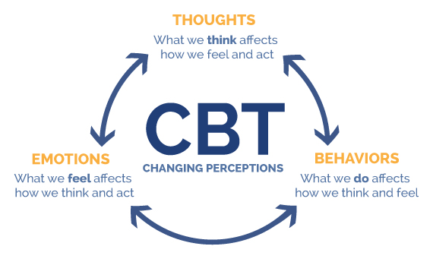
Cognitive behavioral therapy (CBT)
Idea that what one thinks influences what one feels
Replace negative thoughts with helpful or positive thoughts
Image: https://www.integratedhealthcareyork.com/introduction-to-cognitive-behavioural-therapy-cbt/

Slide 59
Dialectical behavior therapy (DBT)
Cognitive behavior treatment
Especially useful with depression and self-harm/suicidal thoughts
Goal is to become aware of emotions and manage emotions
Image: https://www.sunrisertc.com/dialectical-behavioral-therapy/

Slide 60
Exposure therapy- unique to anxiety and OCD
Various techniques to help patients address and confront their fears
View website: https://www.apa.org/ptsd-guideline/patients-and-families/exposure-therapy.aspx

Slide 61
Local resources for anxiety and OCD
Roger’s Memorial Hospital Oconomowoc location has residential anxiety/OCD program https://rogersbh.org/what-we-treat/ocd-anxiety/ocd-and-anxiety-residential-services/adolescent-center-ocd-and-anxiety
Roger’s Memorial Hospital Brown Deer location has PHP and IOP anxiety/OCD programs https://rogersbh.org/what-we-treat/ocd-anxiety/ocd-anxiety-outpatient-services
Outpatient providers: make sure they are trained in exposure and response prevention therapy (ERP) https://iocdf.org/about-ocd/treatment/erp/
Cornerstone Counseling- many locations 262-789-1191 http://www.cornerstonecounseling.com/
Center for Anxiety Disorders (262) 719-3824 http://www.centerforanxietydisorders.net/

Slide 62
Depression

Slide 63
presenting signs and symptoms of Depression
Persistent sad, anxious or "empty" mood
Feelings of hopelessness, pessimism
Feelings of guilt, worthlessness, helplessness
Loss of interest or pleasure in hobbies and activities, including sex
Decreased energy, fatigue, feeling "slowed down"
Difficulty concentrating, remembering, making decisions
Insomnia, early-morning awakening, or oversleeping
Low appetite and weight loss or overeating and weight gain
Thoughts of death or suicide, suicide attempts
Restlessness, irritability
Persistent physical symptoms that do not respond to treatment, such as headaches, digestive disorders and pain for which no other cause can be diagnosed.
https://adaa.org/understanding-anxiety/depression/symptoms

Slide 64
GAD, Depression, both?

Slide 65
Guidelines for Adolescent Depression in Primary Care (GLAD-PC) Toolkit
http://www.glad-pc.org/
At bottom of webpage you can download the document

Slide 66
screening tools for Depression
PHQ-9 https://www.phqscreeners.com/sites/g/files/g10016261/f/201412/instructions.pdf
See next few slides for tool and scoring

Slide 67
GAD and PHQ-9 with instructions https://www.phqscreeners.com/select-screener/36

Slide 68
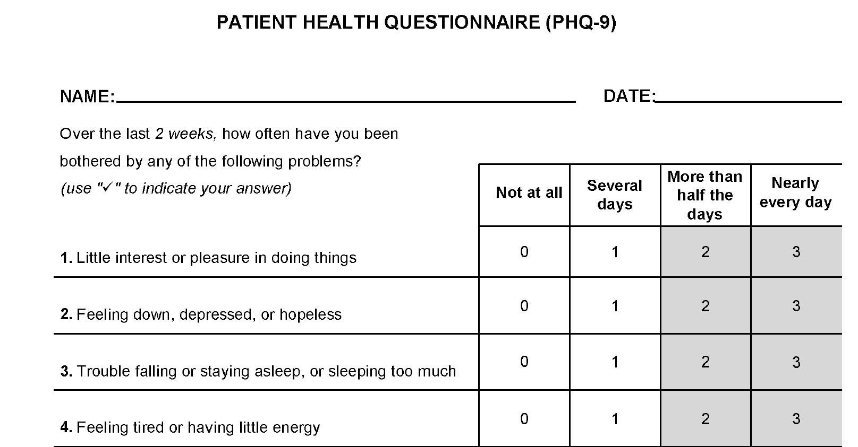
Depression screening
Variety of tools
PHQ-9 is common

Slide 69
PHQ-9 continued

Slide 70
PHQ-9 continued

Slide 71
PHQ-9 initial diagnosis

Slide 72
PHQ-9 monitoring depression

Slide 73
Interpretation of PHQ-9 results

Slide 74
Depression treatment
Behavioral activation therapy
Individual psychotherapy
Cognitive behavioral therapy (CBT)
Dialectical behavior therapy (DBT)

Slide 75
Mood disorder treatment options

Slide 76
Local treatment options
Terminology:
- Outpatient
- Inpatient
- Residential
- PHP-Partial hospitalization program
- IOP- Intensive outpatient program

Slide 77
Outpatient treatment options
More treatment options for depression than for anxiety/OCD as do not need specific ERP training
Make sure specialize in pediatrics
Numerous private therapists, and numerous organizations:
Cornerstone (contact info on previous slide)
American Behavior Clinics (ABC) 414-877-4570 https://americanbehavioralclinics.com/

Slide 78
Milwaukee county resources
(414) 257-7222
Milwaukee Psychiatric Crisis Center
https://county.milwaukee.gov/EN/DHHS/BHD
https://county.milwaukee.gov/EN/DHHS/BHD/Wraparound-Milwaukee

Slide 79
Partial hospitalization programs (PHP)
Full-day, non-residential programs
Transportation can be an issue, some insurances pay for medical transportation
Children do not attend school while in PHP
Last anywhere from 1 week to a few months, depending on the organization, the patient’s needs, and insurance coverage

Slide 80
IOP treatment options
Typically half day programs, approx. 3 hours in length
Patient attends school half of the day, and attends treatment the other half of the day
Allows continuation of routine
Must have transportation- some patients qualify for medical transportation, and others will need to provide transportation

Slide 81
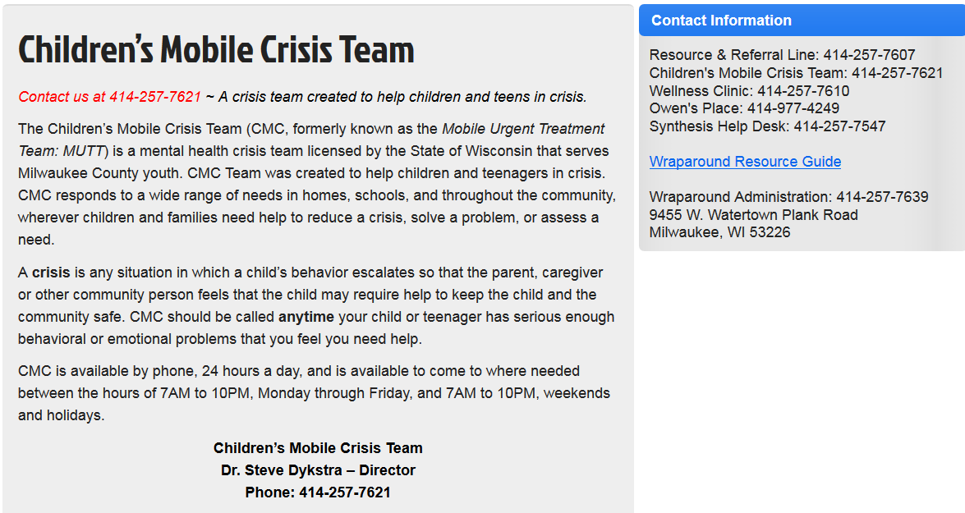
Children’s mobile crisis team (Formerly “M.U.T.T. Mobile unit treatment team”
Contact info: 1414-257-7621 http://wraparoundmke.com/programs/mutt/

Slide 82
Side note about eating disorders….
Aurora and Rogers both have eating disorder treatment
The Redi Clinic is another great treatment center 414-727-4455 http://www.therediclinic.com/
Often associated with mood disorders

Slide 83
Rogers eating disorder Outpatient treatment https://rogersbh.org/what-we-treat/eating-disorders/eating-disorder-outpatient-services

Slide 84
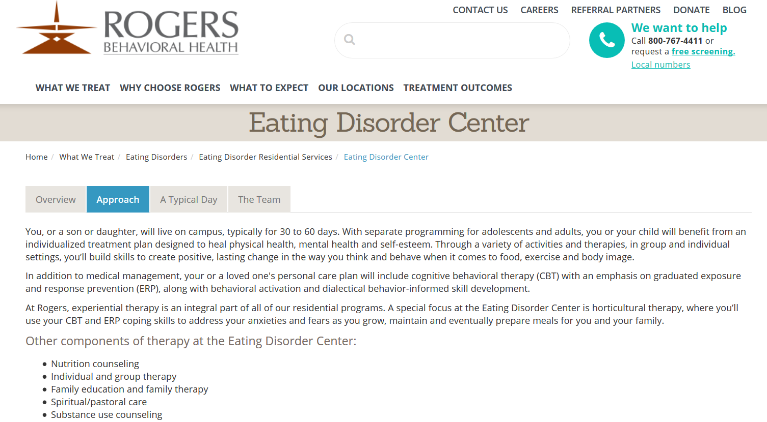
Rogers eating disorder residential treatment https://rogersbh.org/what-we-treat/eating-disorders/eating-disorder-residential-services/eating-disorder-center

Slide 85
Aurora eating disorder treatment https://www.aurorahealthcare.org/services/behavioral-health-addiction/eating-disorders-programs/levels-of-care#InpatientProgram

Slide 86
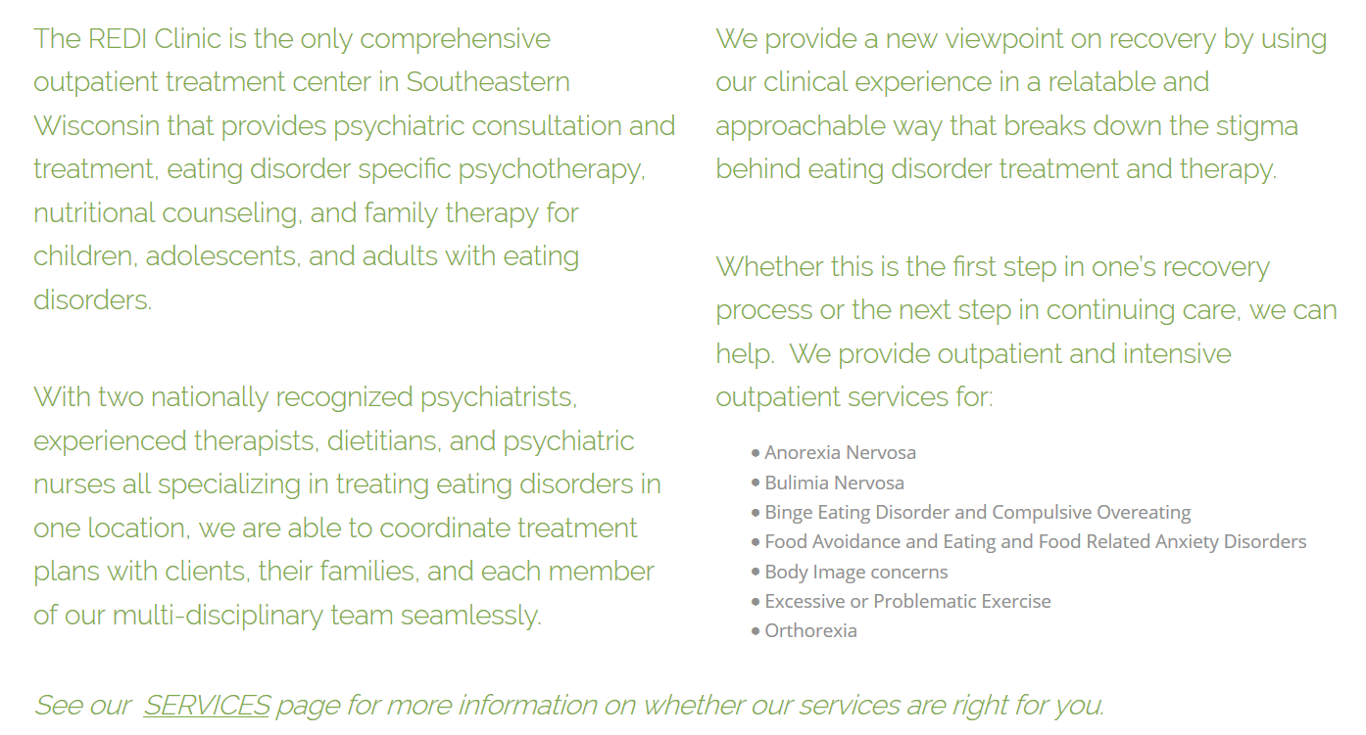
REDI Clinic
http://www.therediclinic.com/

Slide 87
Conclusion
Thank you!
Blessings on your practice and your patients!

Slide 88
References:
Centers for Disease Control www.cdc.gov
Up to Date www.UptoDate.com
Autism Speaks www.Autismspeaks.org
Wisconsin Department of Health Services: Birth to Three https://www.dhs.wisconsin.gov/birthto3/index.htm
American Academy of Pediatrics www.aap.org
National Institutions of Health https://www.nimh.nih.gov/health/topics
Children’s Hospital Seattle https://www.seattlechildrens.org/conditions/brain-nervous-system-mental-conditions/depression/?gclid=Cj0KCQiAgf3gBRDtARIsABgdL3m6Fu_ZlDgwe25T8nKfWyBlVDbb9R07ntBahqOlanBJm3kplFmYsVIaAknoEALw_wcB

Slide 89
References:
CHADD= Children and Adults with Attention-Deficit/Hyperactivity Disorder http://www.chadd.org/Understanding-ADHD/About-ADHD/Data-and-Statistics/General-Prevalence.aspx
Marcdante, et al. (2014). Nelson Essentials of Pediatrics, 7th edition. Saunders
9. United States Preventative Services Task Force
https://www.uspreventiveservicestaskforce.org/Home/GetFileByID/218
University of North Carolina Department of Pediatrics https://www.med.unc.edu/pediatrics/education/current-residents/resources/clinical/unc-general-pediatric-clinic-documents/behavior/screen-for-child-anxiety-related-disorders-scared-parent-form/view

Slide 90
References:
Children’s Hospital of Wisconsin www.chw.org
https://www.chw.org/medical-care/psychiatry-and-behavioral-medicine
https://www.chw.org/medical-care/psychiatry-and-behavioral-medicine/mental-health/crisis-care
Autism Speaks http://communities.autismspeaks.org/site/c.ihLPK1PDLoF/b.7501157/k.8319/Autism_Speaks_in_Wisconsin.htm
Healthy Children https://www.healthychildren.org/English/health-issues/conditions/Autism/Pages/How-Doctors-Screen-for-Autism.aspx
Rogers Behavioral Health www.rogersbh.org/
Aurora Health Care Child and Adolescent Behavioral Health https://www.aurorahealthcare.org/services/behavioral-health-addiction/child-and-adolescent

