Slide 1
Obstructive sleep apnea Is that snoring more than just annoying?
Alysa Blum, PA-C
Waukesha Employee Health and Wellness Center

Slide 2
Objectives
Recognize signs and symptoms of OSA
Know how to appropriately screen for OSA
Understand the consequences of untreated OSA
Understand basics of referral and treatment
OSA special cases

Slide 3
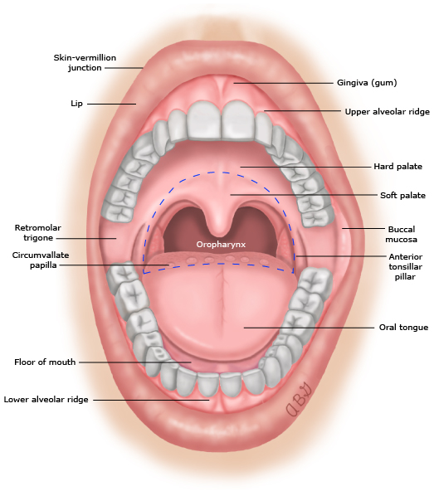
Pathophysiology
Notes:
Recurrent functions collapse during sleep of the velopharyngeal and/or oropharyngeal airway
Causes reduced or complete cessation of airflow
Leads to intermittent disturbances in gas exchange (hypercapnia and hypoxemia) and fragmented sleep
We all have narrowing of UA during sleep as muscles relax (can lead to audible breathing in healthy individuals→snoring; fluttering of the soft palate and UA soft tissue)
Not all who snore have OSA, but most with OSA will snore
Unfavorable anatomic UA susceptibility + sleep related changes in UA function
i.e.: Relaxation of muscles, reduced responsiveness, rostral increase of blood flow

Slide 4
Risk factors
Advancing age
Male gender
Obesity
Craniofacial or upper airway soft tissue abnormalities
Medical conditions
Other?
Notes:
Advancing age (skin sags everywhere)
Male gender
Obesity
Craniofacial or upper airway soft tissue abnormalities
Abnormal maxillary or short mandibular size (Asian population)
Wide craniofacial base
Tonsillar hypertrophy
Adenoid hypertrophy
Other?
Smoking
Nasal congestion
Menopause
Family history
Medical conditions
Pregnancy
ESRD
CHF
Chronic lung disease
Stroke

Slide 5
What does OSA “look” like?
Obesity
Crowded oropharyngeal airway
Large neck circumference
Hypertension—also that is resistant!
Notes:
But don’t forget those that don’t necessarily fit the mold!

Slide 6
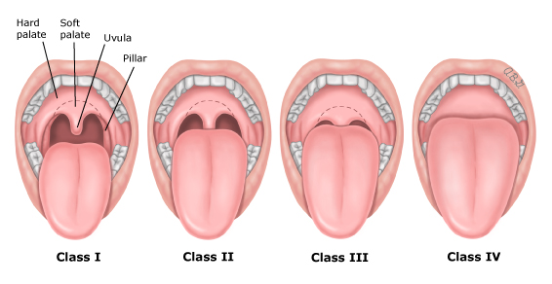
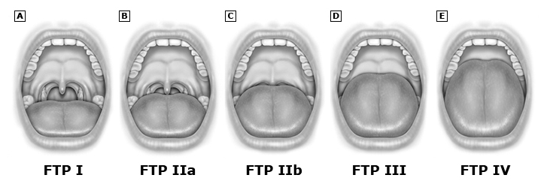
Notes:
Mallampati vs. Friedman

Slide 7
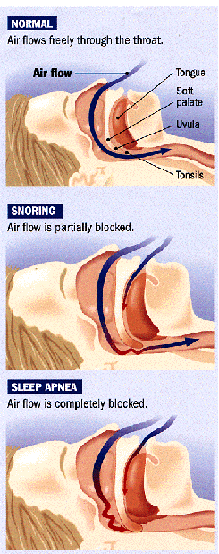
Signs and Symptoms
Snoring and daytime sleepiness (sensitive but not specific!)
Nocturnal choking or gasping
Restless sleep
Poor concentration
Nocturia
Morning HA
http://www.sleephealth.com

Slide 8
Screening
Questionnaires are sensitive but not specific
Epworth: can gage a patient’s sleepiness
Stop-bang (snoring, tiredness, observed apneas, BP, BMI, age, neck circumference, gender
Highest sensitivity
Helpful to get sleep study approved with insurance
ROS form: can include sleep related questions to help catch those at risk

Slide 11
Diagnosis
In lab polysomnography
GOLD standard
Best for:
Suspected complicated OSA
Other breathing issues
Mission-critical workers
Home sleep apnea testing (HSAT)
Good alternative that many patients prefer
Best for:
Strong suspicion of OSA
No major medical comorbidities

Slide 13
HSAT
Nasal pressure/Airflow
Thoracic and abdominal effort belts
Pulse oximeter

Slide 15
Definitions/Summary of results
Apnea: 90% or greater decrease in airflow for 10 secs
Hypopnea: reduction of airflow but does not meet definition of apnea
RERA: respiratory effort-related arousals-arousals that are associated with change in airflow that don’t meet above definitions
AHI (apnea-hypopnea index): adding together number of apneas and hypopneas and dividing by the sum of total sleep (in hours)
AHI > 15 = OSA, or >5 + other s/s
RDI (respiratory disturbance index): apneas + hypopneas + RERAs, and dividing the sum by the total sleep in hours (thus typically RDI will be somewhat higher than AHI)
Degree of hypoxemia

Slide 16
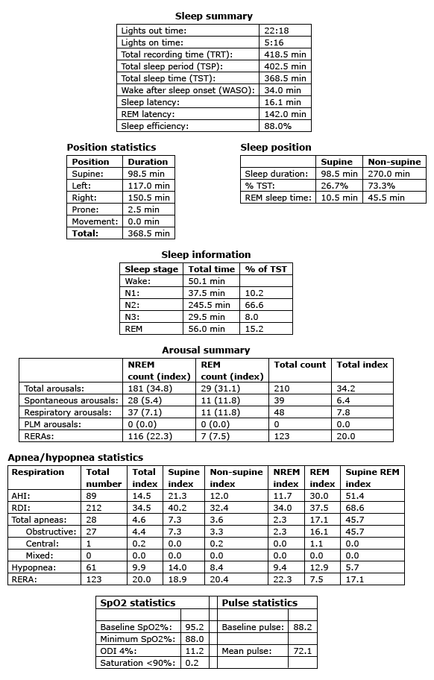

Slide 17
Severity of OSA
AHI: 15-25: Mild OSA
AHI: 25-40 Moderate OSA
AHI > 40: severe OSA
Notes:
Why is this important: Importance of treatment and how much it can be reduced with various treatments!

Slide 18
Consequences of untreated OSA
Daytime function
Psychiatric
Driving implications
Cardiovascular events
Metabolic syndrome and T2DM
NAFLD
Perioperative complications
Mortality
Notes:
Daytime function (sleepiness, impaired function at work),
Psychiatric: higher risk of depression
Drowsy driving and MVAs (2-3X more common)
Cardiovascular effects
HTN
CAD
Arrhythmias (Reggie White, 43)
Heart failure
Stroke
Why:
apnea created hypoxemia and hypercapnia and arousal from sleep; creates inflammatory and effects on the vessels that can contribute to cardiovascular disease
increased sympathetic activity during sleep—influences HR and BP
Metabolic syndrome and T2DM
Due to obesity
But also independent risk factor
NAFLD
d/t intermittent nocturnal hypoxemia (independent of shared RF)
Perioperative complications
Mortality
2-3X increased in death for those with AHI > 30 independent of other RF

Slide 20
Treatment of OSA
Weight loss and CPAP are cornerstones of therapy
Other: oral appliances, upper airway surgery and hypoglossal nerve stimulation
Ordering supplies
Referrals
Notes:
Utilize sleep medicine providers (have them do follow-up after you order a test)-they can then order supplies, conduct f/u; help patient be successful
If needed: Be the patient advocated—there are many different companies/suppliers and the patient is a consumer. These companies should want to do everything in their power to make CPAP comfortable/successful, because otherwise the patient isn’t using it; and they aren’t getting paid.
CPAP is not tracked and data/and use is stored on the cloud; sleep specialists or you if you are managing can see how compliant patients are and how effective it is!
Not your old-fashioned CPAP; many are smaller, more portable, MANY different masks!
May need to utilize ENT if nasal breathing or sinus issues are creating compliance issues with CPAP

Slide 21
Patient presentation
57 yo male
Initially presented for HRA follow up after he had several RF
Elevated BP, elevated TGL, elevated fasting BS, obesity and tobacco use
Has not had care in over 1 year, had been on BP meds, but has been inconsistent with use

Slide 22
History
Social Hx
Works in a foundry operating a crane
75 pack year smoking history
Inactive lifestyle
Mild-moderate drinking
Past Medical Hx
HTN?
Chronic sinusitis

Slide 23
Sleep history
When asked: “I do not sleep well”
Wakes up often
+snoring and witnessed apneas by wife
Feels tired daily and c/o daytime somnolence
States he would like to quit smoking and start exercising but feels too tired to accomplish these things

Slide 24
Vitals
BP: 160/102
HR: 90
BMI: 40

Slide 25
Exam
General Appearance: Obese male, in no acute distress
Neck: 17 inches circumference
Nose: turbinates red and swollen, limited airflow through nares
Oral cavity/throat: +base of tongue hypertrophy and redundancy of the uvula and soft palate; Friedman class 3
Heart: Regular rate and rhythm, no M/R/G
Lungs: clear to auscultation bilaterally

Slide 26
Source: X. Barcelo and others, “Oropharyngeal Examination to Predict Sleep Apnea Severity,” Archives of Otolaryngology—Head and Neck Surgery 137, no. 10 (2011): 990-996.

Slide 27
Assessment and plan
Hypertension
Started on Lisinopril 20 mg
Snoring/likely obstructive sleep apnea
Ordered home sleep study
Tobacco use
Encouraged smoking cessation

Slide 28
Sleep study results
AHI: 54.8
Lowest PO2: 78%
Average PO2: 90%
AHI while supine: 105.7
Severe sleep apnea

Slide 29
Follow-up
BP improved: 130/90
Received CPAP
Struggling with consistent use with hunting
Chronic sinusitis causing difficulty with mask

Slide 30
Pediatric OSA
Who?
Between 1-5% of children, most often between the ages of 2-6
Risks: adenotonsillar hypertrophy and obesity
Signs and symptoms
Nocturnal: snoring, mouth breathing, waking, nighttime sweating
Daytime: somnolence, inattention, learning problems and behavioral problems
Consequences: Growth and cardiopulmonary

Slide 31
Notes:
History: snoring, labored breathing or pauses, nocturnal enuresis, learning or behavior problems, sleepiness
Exam: Growth (obesity and poor growth/FTT), cardiopulmonary, head and nose, mouth

Slide 32
Diagnosis, referral and treatment
Refer to ENT or sleep medicine
Best if pediatric!
Often adenoidectomy and tonsillectomy are curative

Slide 33
OSA and DOT
Current standard
49 CFR 391.41 (b) (5) of the Federal Motor Carrier Safety Regulations
No established medical history or clinical diagnosis of respiratory dysfunction likely to interfere with the ability to control and drive a commercial motor vehicle safely
FMCSA Medical Advisory Board recommends mandatory objective OSA screening of CDL holders with BMI > 30
2007: specific recommendations for the screening, licensing and treatment of patients at risk for or with OSA, but none of these have been officially implemented by FMCSA
Sleep apnea rule was withdrawn august 2017: Give Clarity to medical examiners, carrier employers, and drivers themselves about what criteria or combination of criteria would prompt a driver to be referred to an in-lab apnea test, as well as treatment protocol
Notes:
WHY? Difficult to implement; as many as 40% of drivers would be affected!

Slide 34
Current standard from FMCSA
No certification for those with OSA until treatment is seen to be stable, safe and effective
Waiting period:
1 month after CPAP initiation
3 months symptom free after surgery
Notes:
This encourages drivers to not be screened or treated, lie about symptoms, so examiners, but ALL practitioners much be diligent in screening and recommending treatment!

Slide 35
References
Epstein LJ; Kristo D; Strollo PJ; Friedman N; Malhotra A; Patil SP; Ramar K; Rogers R; Schwab RJ; Weaver EM; Weinstein MD. Clinical guideline for the evaluation, management and long-term care of obstructive sleep apnea in adults. J Clin Sleep Med 2009;5(3):263–276.
Kline, L, Clinical presentation and diagnosis of obstructive sleep apnea in adults. In: Uptodate, Collop, N (ED), Uptodate, Waltham, MA, 2018.
Kryger, MH, Malhotra, A. Management of obstructive sleep apnea in adults. In: Uptodate, Collop, N (ED), Uptodate, Waltham, MA, 2018.
Mehra, R. obstructive sleep apnea and cardiovascular disease in adults. In: Uptodate, Collop, N (ED), Uptodate, Waltham, MA, 2018.
QaseemA, Holty JE, Owens DK, et al. Management of obstructive sleep apnea in adults: A clinical practice guideline from the American College of Physicians. Ann Intern Med 2013; 159:471.
Strohl, K. Overview of obstructive sleep apnea in adults. In: Uptodate, Collop, N (ED), Uptodate, Waltham, MA, 2018.

